Slide 1


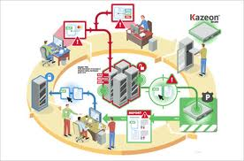
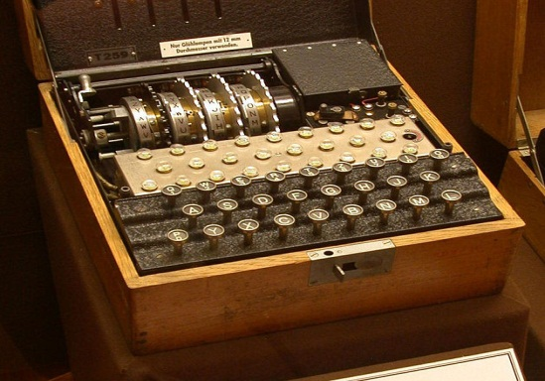
Introduction to
Information Security
Buffer Overflow
Chunhua Chen, Ph.D. / 陈春华 博士
chunhuachen@scut.edu.cn
South China University of Technology
22st March 2013
Note: slides borrowed from Prof. Mark Stamp@sjsu
Intro to InfoSec
Spring 2013
Dr. Chunhua Chen
chunhuachen@scut.edu.cn
<number>/27

Slide 2
Possible Attack Scenario
Users enter data into a Web form
Web form is sent to server
Server writes data to array called buffer, without checking length of input data
Data “overflows” buffer
  Such overflow might enable an attack
  If so, attack could be carried out by anyone with Internet access
Intro to InfoSec
Spring 2013
Dr. Chunhua Chen
chunhuachen@scut.edu.cn
<number>/27
Part 4 ⎯ Software <number>

Slide 3
Buffer Overflow
int main(){
char buffer[10];
buffer[20] = ‘B’;
}
Q: What happens when code is executed?
A: Depending on what resides in memory at location “buffer[20]”
  Might overwrite user data or code
  Might overwrite system data or code
  Or program could work just fine
Intro to InfoSec
Spring 2013
Dr. Chunhua Chen
chunhuachen@scut.edu.cn
<number>/27

Slide 4

Simple Buffer Overflow
Consider boolean flag for authentication
Buffer overflow could overwrite flag allowing anyone to authenticate
Boolean flag
buffer
F
O
U
R
S
C
…
T
F
In some cases, Trudy need not be so lucky as in this example
Intro to InfoSec
Spring 2013
Dr. Chunhua Chen
chunhuachen@scut.edu.cn
<number>/27

Slide 5
Memory Organization
Text == code
Data == static variables
Heap == dynamic data
Stack == “scratch paper”
  Dynamic local variables
  Parameters to functions
  Return address
low
address
text
data
heap
↓
↑
stack
pointer (SP)
stack
high
address
Intro to InfoSec
Spring 2013
Dr. Chunhua Chen
chunhuachen@scut.edu.cn
<number>/27

Slide 6
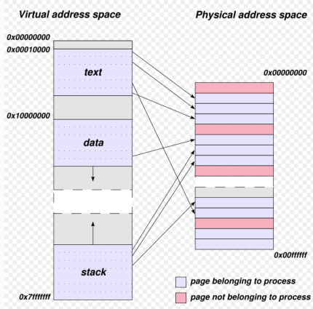
Intro to InfoSec
Spring 2013
Dr. Chunhua Chen
chunhuachen@scut.edu.cn
<number>/27

Slide 7
Simplified Stack Example
low →
void func(int a, int b){
char buffer[10];
}
void main(){
func(1, 2);
}
:
:
SP
buffer
SP
ret
return
address
a
SP
high →
b
SP
Intro to InfoSec
Spring 2013
Dr. Chunhua Chen
chunhuachen@scut.edu.cn
<number>/27

Slide 8
Smashing the Stack
low →
What happens if buffer overflows?
???
:
:
Program “returns” to wrong location
buffer
SP
overflow
SP
A crash is likely
ret
ret…
NOT!
overflow
a
SP
high →
b
SP
Intro to InfoSec
Spring 2013
Dr. Chunhua Chen
chunhuachen@scut.edu.cn
<number>/27

Slide 9
Smashing the Stack
low →
Trudy has a better idea…
:
:
Code injection
Trudy can run code of her choosing…
  …on your machine
SP
evil code
ret
ret
SP
a
SP
high →
b
SP
Intro to InfoSec
Spring 2013
Dr. Chunhua Chen
chunhuachen@scut.edu.cn
<number>/27

Slide 10
Smashing the Stack
:
:
Trudy may not know…
  Address of evil code
  Location of ret on stack
Solutions
  Precede evil code with NOP “landing pad”
  Insert ret many times
NOP
:
NOP
evil code
ret
ret
ret
:
ret
:
:
Intro to InfoSec
Spring 2013
Dr. Chunhua Chen
chunhuachen@scut.edu.cn
<number>/27

Slide 11
Stack Smashing Summary
A buffer overflow must exist in the code
Not all buffer overflows are exploitable
  Things must align properly
If exploitable, attacker can inject code
Trial and error is likely required
  Fear not, lots of help is available online
  Smashing the Stack for Fun and Profit, Aleph One
  http://www.uml.org.cn/safe/201212174.asp
Stack smashing is “attack of the decade”
  Regardless of the current decade
  Also heap overflow, integer overflow, …
Intro to InfoSec
Spring 2013
Dr. Chunhua Chen
chunhuachen@scut.edu.cn
<number>/27

Slide 12
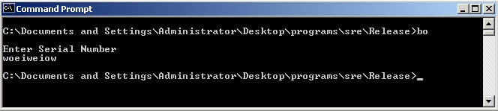
Stack Smashing Example
Program asks for a serial number that the attacker does not know
Attacker does not have source code
Attacker does have the executable (exe)
Program quits on incorrect serial number
Intro to InfoSec
Spring 2013
Dr. Chunhua Chen
chunhuachen@scut.edu.cn
<number>/27

Slide 13
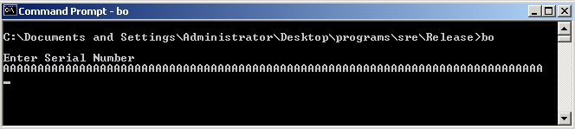
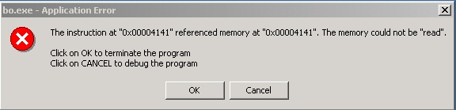
Buffer Overflow Present?
By trial and error, attacker discovers apparent buffer overflow
Note that 0x41 is ASCII for “A”
Looks like ret overwritten by 2 bytes!
Intro to InfoSec
Spring 2013
Dr. Chunhua Chen
chunhuachen@scut.edu.cn
<number>/27

Slide 14
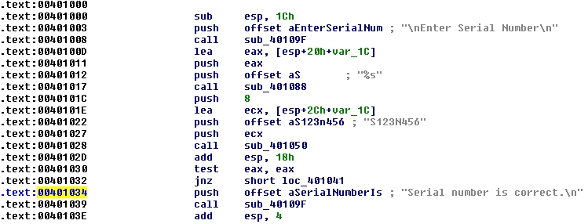
Disassemble Code
Next, disassemble bo.exe to find
The goal is to exploit buffer overflow to jump to address 0x401034
Intro to InfoSec
Spring 2013
Dr. Chunhua Chen
chunhuachen@scut.edu.cn
<number>/27

Slide 15
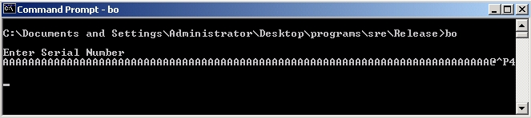
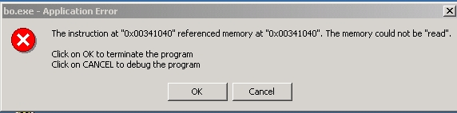
Buffer Overflow Attack
Find that, in ASCII, 0x401034 is “@^P4”
Byte order is reversed? Why?
X86 processors are “little-endian”
Intro to InfoSec
Spring 2013
Dr. Chunhua Chen
chunhuachen@scut.edu.cn
<number>/27

Slide 16
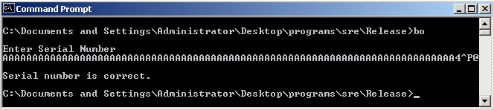
Overflow Attack, Take 2
Reverse the byte order to “4^P@” and…
Success! We’ve bypassed serial number check by exploiting a buffer overflow
What just happened?
  Overwrote return address on the stack
Intro to InfoSec
Spring 2013
Dr. Chunhua Chen
chunhuachen@scut.edu.cn
<number>/27

Slide 17
Buffer Overflow
Attacker did not require access to the source code
Only tool used was a disassembler to determine address to jump to
Find desired address by trial and error?
  Necessary if attacker does not have exe
  For example, a remote attack
Intro to InfoSec
Spring 2013
Dr. Chunhua Chen
chunhuachen@scut.edu.cn
<number>/27

Slide 18
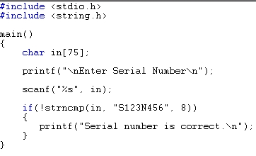
Source Code
Source code for buffer overflow example
Flaw easily found by attacker…
…without access to source code!
Intro to InfoSec
Spring 2013
Dr. Chunhua Chen
chunhuachen@scut.edu.cn
<number>/27

Slide 19
Stack Smashing Defenses
Employ non-executable stack, e.g. Microsoft’s DEP
  “No execute” NX bit (if available)
  Seems like the logical thing to do, but some real code executes on the stack (Java, for example)
Use a canary, e.g. Microsoft’s security cookie
Address space layout randomization (ASLR)
Use safe languages (Java, C#)
Use safer C functions
  For unsafe functions, safer versions exist
  For example, strncpy instead of strcpy
Intro to InfoSec
Spring 2013
Dr. Chunhua Chen
chunhuachen@scut.edu.cn
<number>/27

Slide 20
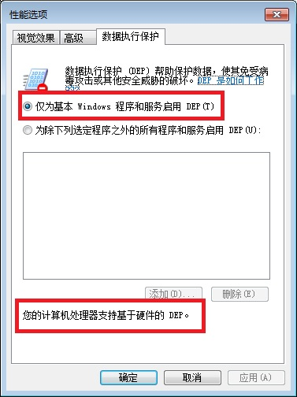
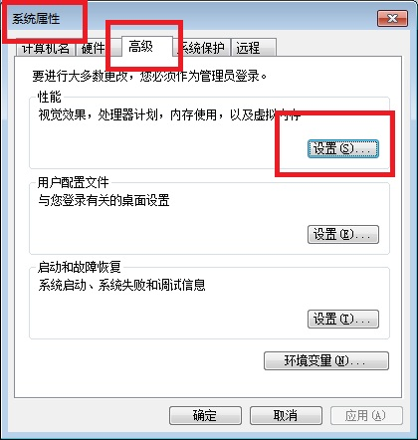
Microsoft’s DEP
Intel (R) Core(TM) i7-3770 CPU @3.40GH 64 bit
Windows 7 Operating System
Intro to InfoSec
Spring 2013
Dr. Chunhua Chen
chunhuachen@scut.edu.cn
<number>/27

Slide 21
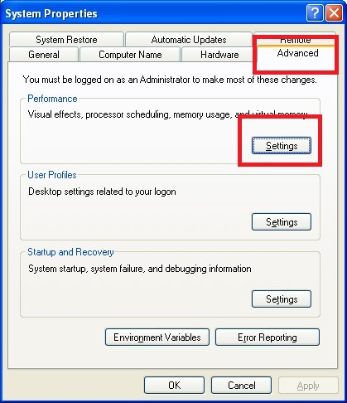
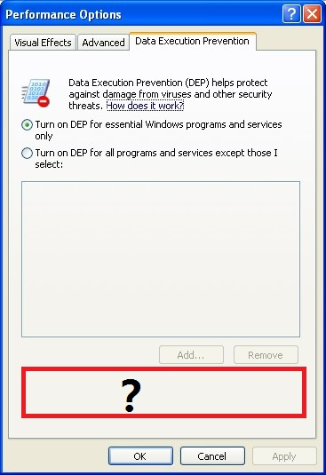
Microsoft’s DEP
Intel (R) Core (TM) 2 Duo CPU P8400 @2.26
Windows XP Professional Version 2002 Service Pack 3
Intro to InfoSec
Spring 2013
Dr. Chunhua Chen
chunhuachen@scut.edu.cn
<number>/27

Slide 22

Stack Smashing Defenses
low →
Canary
  Run-time stack check
  Push canary onto stack
  Canary value:
    Constant 0x000aff0d
    Or may depends on ret
:
:
buffer
overflow
canary
overflow
ret
a
high →
b
Intro to InfoSec
Spring 2013
Dr. Chunhua Chen
chunhuachen@scut.edu.cn
<number>/27

Slide 23
Microsoft’s security cookie
Microsoft added buffer security check feature to C++ with /GS compiler flag
  Based on canary (or called ‘security cookie)
Q: What to do when canary dies?
A: Check for user-supplied “handler”
Handler shown to be subject to attack
  Claim that attacker can specify handler code
  If so, formerly “safe” buffer overflows become exploitable when /GS is used!
Intro to InfoSec
Spring 2013
Dr. Chunhua Chen
chunhuachen@scut.edu.cn
<number>/27

Slide 24
ASLR
Address Space Layout Randomization
  Randomize place where code loaded in memory
Makes most buffer overflow attacks probabilistic
Windows Vista uses 256 random layouts
  So about 1/256 chance buffer overflow works?
Similar thing in Mac OS X and other OSs
Attacks against Microsoft’s ASLR do exist
  Possible to “de-randomize”
Intro to InfoSec
Spring 2013
Dr. Chunhua Chen
chunhuachen@scut.edu.cn
<number>/27

Slide 25
Buffer Overflow
A major security threat yesterday, today, and tomorrow
The good news?
It is possible to reduced overflow attacks
  Safe languages, NX bit, ASLR, education, etc.
The bad news?
Buffer overflows will exist for a long time
  Legacy code, bad development practices, etc.
Intro to InfoSec
Spring 2013
Dr. Chunhua Chen
chunhuachen@scut.edu.cn
<number>/27

Slide 26

Further Reading:
http://en.wikipedia.org/wiki/Buffer_overflow_protection
http://msdn.microsoft.com/en-us/library/aa290051(v=vs.71).aspx
http://msdn.microsoft.com/zh-cn/library/8dbf701c.aspx
http://blog.csdn.net/chengyun_chu/article/details/4644227
http://msdn.microsoft.com/zh-cn/library/bb384887.aspx
http://www.uml.org.cn/safe/201212174.asp
Intro to InfoSec
Spring 2013
Dr. Chunhua Chen
chunhuachen@scut.edu.cn
<number>/27

